Slide 1


Shri S’ad Vidya Mandal Institute of Technology Department of Computer Science & Engineering Bharuch, Gujarat B. E. IV, Semester - VIII Academic Year 2021-2022 Presentation on: Internship-Mid Sem Review Presented By: Guided By: Premkumar P. Patel(180450131035) Prof. Ghanshyam I. Prajapati

Slide 2
COMPANY OVERVIEW
Company Name: Tops Technologies Pvt. Ltd
Address : 301 Jeevandeep Complex, Ring Rd, next to Nirmal Hospital, Surat, Gujarat 395002.
Contact No: 70695 98828
Email Id: surat@tops-int.com
Training Guide’s Detail:-
Name: Jahnvi Patel
Email: jahnvi.patel@tops-int.com
Mobile no. : 99789 63532
Project Guide’s Detail:-
Name: Jay Kothari
Email: jay.Kothari@tops-int.com
Mobile no. : 89805 36957

Slide 3

Internship Domain: Python Django
Internship Duration: 3-4 Months
Internship Mode: Offline
Joining Date: 10/01/2022

Slide 4
Internship Divided Into Two Parts
Project
Training
Duration : 5-6 Weeks
Duration :6th Week Onwards

Slide 5
MONTH: JANUARY-2022

Slide 6
Week 1: SDLC
• On the first there was an Introduction session and Office tour.
• I met and had a talk with my training mentor about the training flow and time duration
• Then I was introduced with the Tops ERP system that tracks our progress and have assignments questions in it.
• Then I was given some basic information about types of softwares .
• Then they asked me if I knew about the Software development life cycles and their models
• After that I was given a brief about the SDLC Life Cycle and Models
• Then I was asked to complete the assignments based on the topics that were covered during that time

Slide 7
Week 2: Fundamentals of python language
• In the second week I was introduced with the Python language
• I was taught about the benefits and applications of python language
• Then I was given some problems to solve in C language to test my knowledge and logic formation
• I got to know about the advantages of python over C language
• Then I was taught about some very basics of python language like syntax, data types, conditional statements and I performed some programs based on these topics
• Then I was introduced with loops in python like for loop, while, do-while loops,nested loops
• Solved assignments regarding these topics and submitted to my mentor

Slide 8
Week 3: Fundamentals of python(Cont.)
• Then I got to know about some control statements that are used to control the loops
• Control statements like break, pass, continue and their differences and uses
• Then I was taught about one datatype called ‘string’
• Then I learned to manipulate strings by concatenating and type casting the string to some other data type and vice versa
• Then I performed some actions on string like string slicing
• I learned and used various string methods that are in-built in python
• I completed the assignments given by my mentor about strings and submitted.

Slide 9
Week 4:Python - Collections, functions and Modules in Python
The next thing was to learn about collection data types used in python just as arrays in C
Python provides four different collection data types List,Tuple,Dictionary,Set
I learned the difference between list and tuples and their properties and uses
Learned about the widely used data type : ‘Dictionaries’ its properties and uses
Learned to access all of these data types in python program
Completed assignments for these topics

Slide 10
Week 4:Python - Collections, functions and Modules in Python(Cont.)
Then I was introduced with the very important concept of Python Language called Functions
I learned about function definition and function calling
Learned about types of functions and their uses
Learned about an anonymous function called lambda function its uses and properties
Learned and used some built in modules provided in python like random and math module
Completed assignments related to uses of function.

Slide 11
MONTH: FEBRUARY-2022

Slide 12
Week 1: Advance python programming
• After all the basic concepts were covered and practiced, A new mentor was assigned to me for further learnings and project development
• I learned to open and close files in python and and perform read and write operations on them
• I learned Exception handling and its uses and different types
• I learned OOPs concepts like classes, objects and inheritance
• Everything that required from python to develop a project was taught in this week

Slide 13
Week 2: Django Introduction
Then I was introduced with Django Framework.
Django is a web framework that works in Python for developing Web applications
I learned about Django , its applications and uses and why it is trending for back-end development of web applications today.
Django works on the MVT architecture i.e Model View Template so I learned the flow of project during execution
Then my mentor showed me how to create and setup an environment that is required to bind the project inside one environment
Created environments for demo project for having hands on practice

Slide 14
Week 3 & 4: Project setup
In this week my mentor assigned me a project that I was supposed to be working with in Future
Project Name: E- Housing Helping Society
Project Definition: The Housing Helping Society is web application that manages society by houses with members details.
Technologies to be used-
Front End: Bootstrap 5 (Templates were Provided by my mentor that needed certain modifications)
Backend: Python Django

Slide 15
Cont.
Defined requirements and required functions that will be required in this project
I made supporting Documentations and Diagrams.
Setup a project environment for my Project
Installed Django library in my Project environment.
Learned to render templates in Django live server
Learned to load all the static files in the templates and perform load static on my templates
Learned to define urls in urls.py file and created necessary function in views.py for performing actions after a certain url is hit.

Slide 16
MONTH: MARCH-2022

Slide 17
Week 1:
Edited sign-up and sign-in page and created tables in models using class and objects
Made functions in views for defining validations and actions that are required to perform when the user clicks the submit button
Implemented otp validation using email function that sends an otp to user’s email to verify the user
Created functionality ‘Forgot-Password’ that allows user to login using a new password sent to their mail in case if they have forgotten theirn password

Slide 18
Week 2:
Created functionality ‘Change Password’ that allows user to create a new password if he/she wants to change their old password
Created a template ‘Edit-Profile’ that has a form in it that allows user to change their basic details after logging into the portal
Made relevant function for the same
Based on the learnings till now, created a simple application ‘employee form’ that takes all details of the employees entered by them and stores it in the database

Slide 19
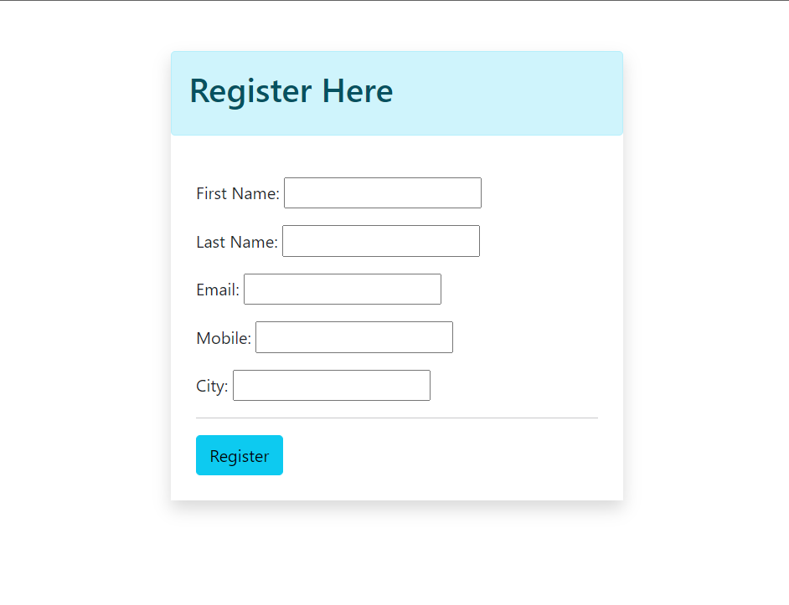
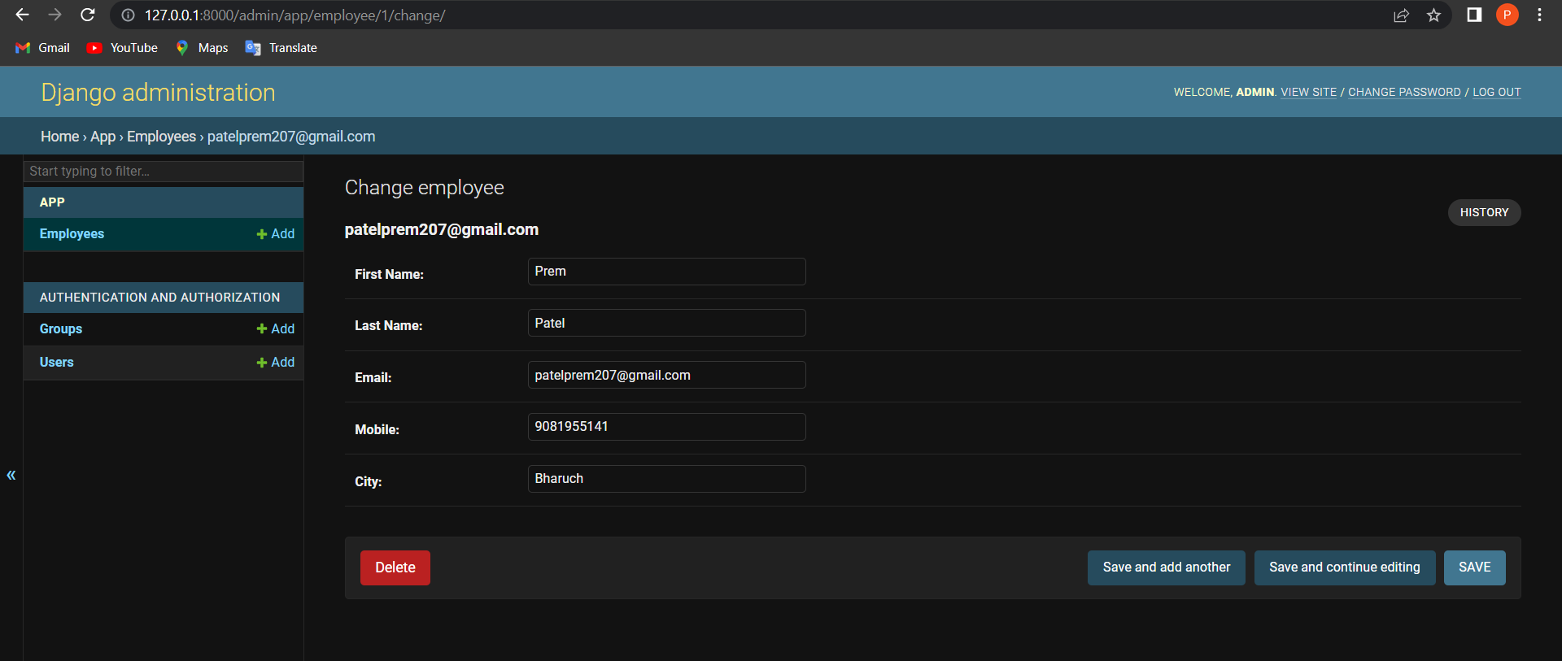

Slide 20
Week 3:
Learned to get data from database on the HTML page by making functions that fulfil the requirements
Based on the learnings created two functionalities in a different project provided by mentor
Add Services
Display Services
Made relevant models(database) in the models.py file to fetch the data form it and display it on the template
Implemented functionality to perform CRUD operations on the database

Slide 21
Week 4:
After completing the task provided by mentor I implemented some functionalities that are required in my project
Made a template called ‘Add a Member’ in the admin dashboard that aloows the admin of the society to register a member in their Society
This functionality adds the member to the database and sends them their login credentials to their respective mail ids that they can use to login in the members portal
Added ‘Change my Details’ function in the members portal that allows the member to edit his details

Slide 22
Future Enhancements
To Implement Payment integration in the project that allows the members to pay their monthly Maintenance fees.
To Create a function that allows members to advertise their house for sale/rent on the website
To Make a parking allotment facility in the member portal that allows the house owners to request for a parking space allotment
To Make a Club-House booking facility for the members to book the club house for their family functions

Slide 23
Project Snapshots

Slide 24
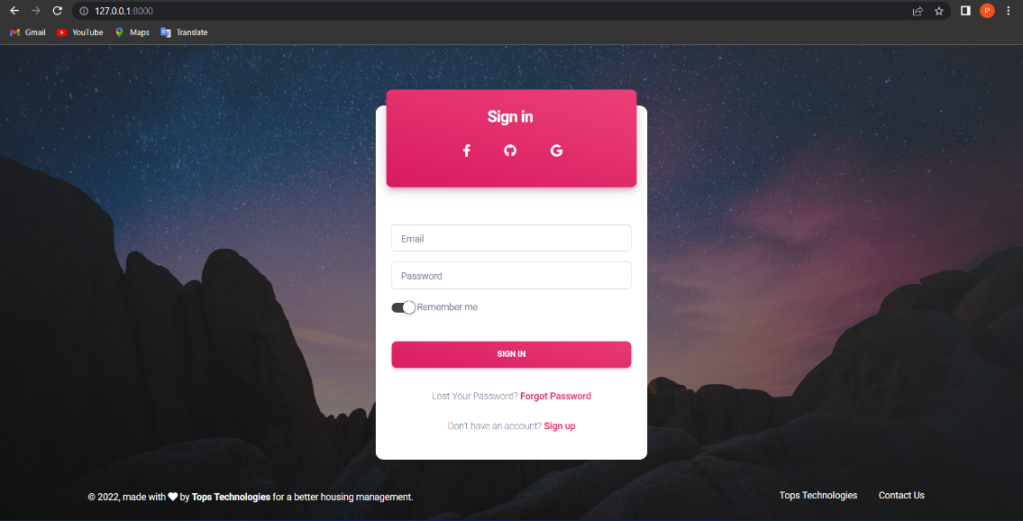
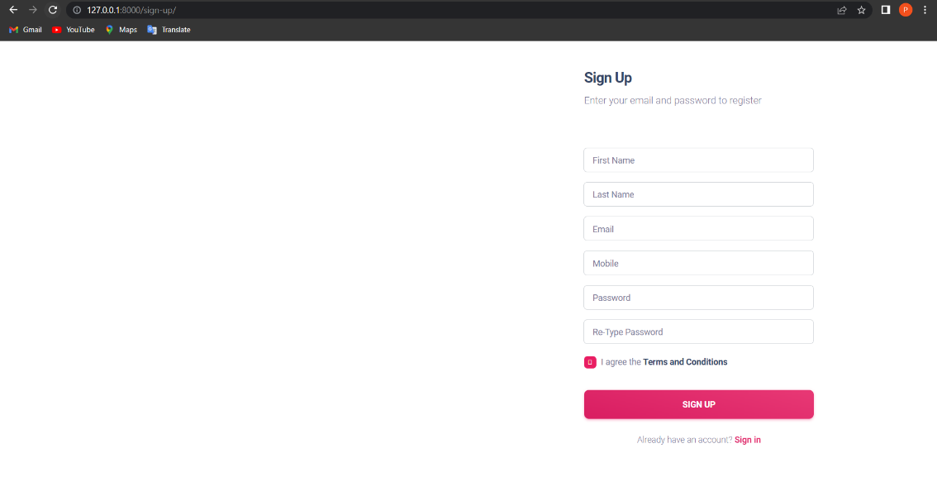
Sign-In and Sign-Up Template

Slide 25
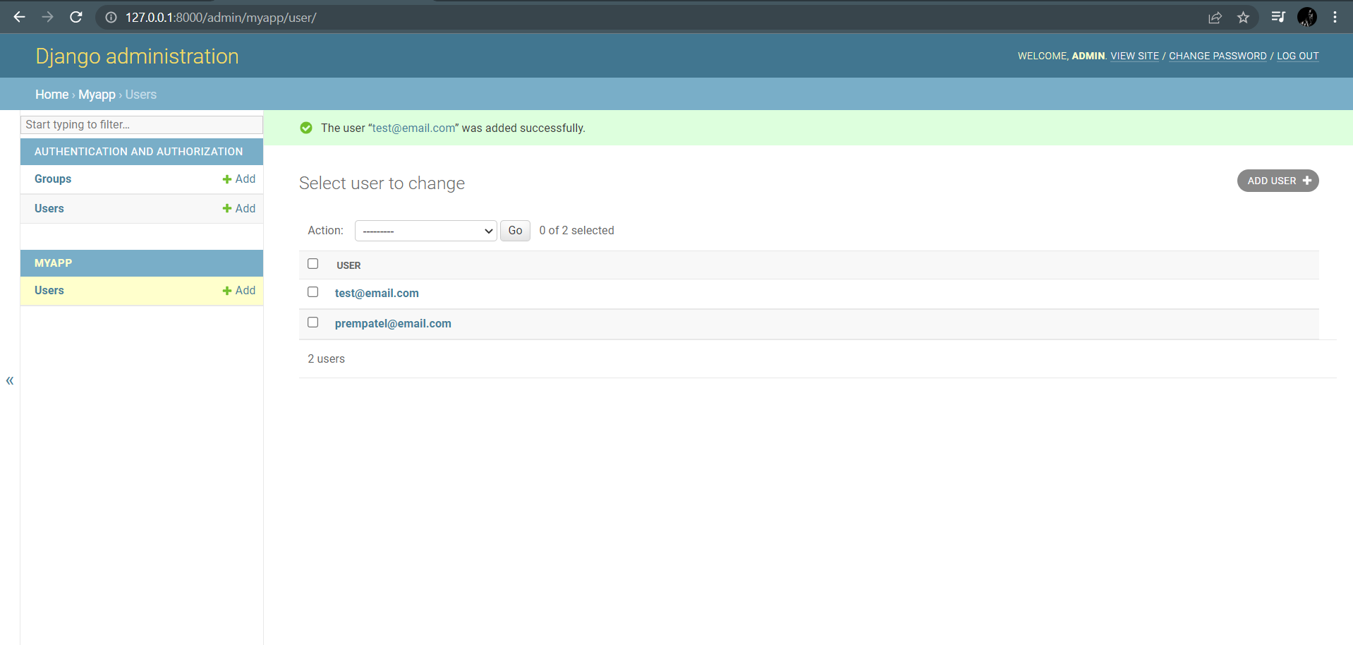
Admin added to the Database

Slide 26
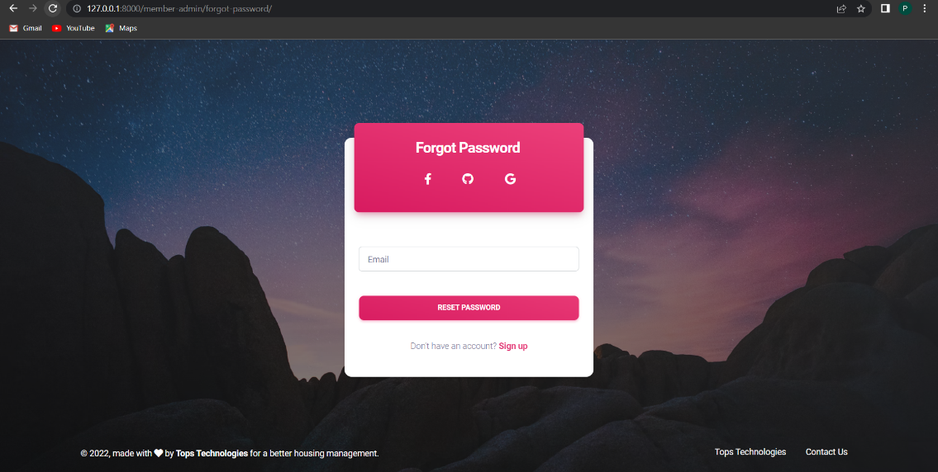
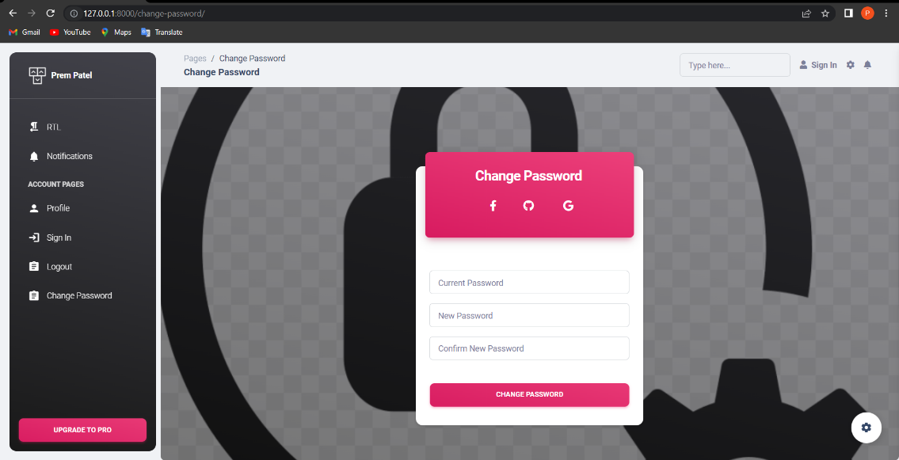
Forgot Password and Change Password

Slide 27
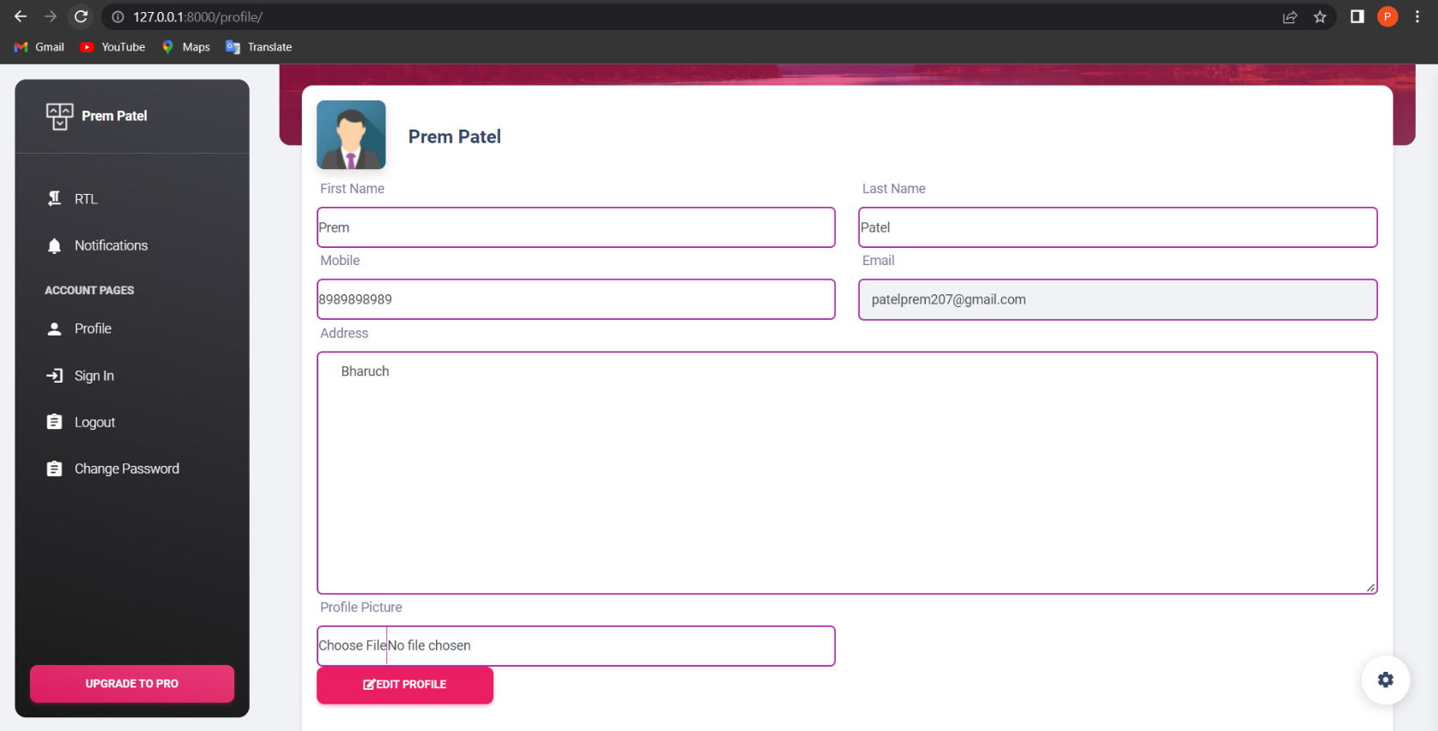
Edit Admin Profile

Slide 28
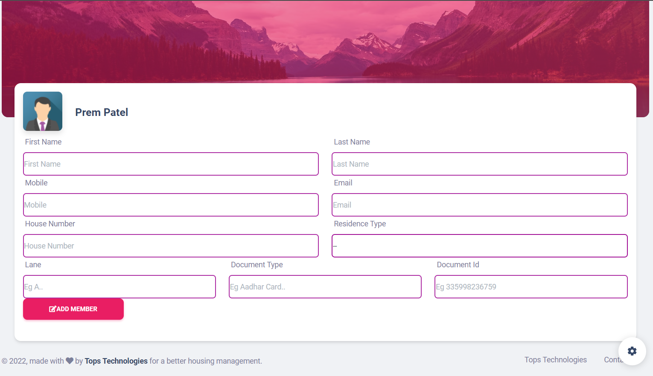
Add Member from Admin Panel

Slide 29
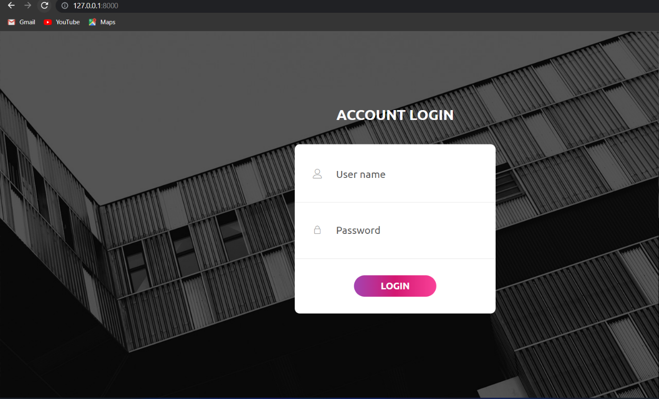
Member Login

Slide 30
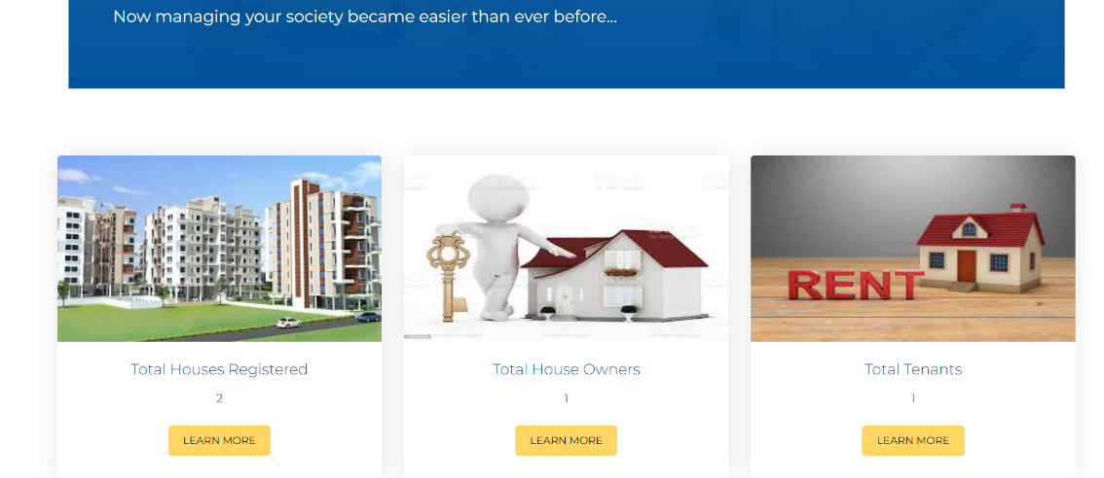
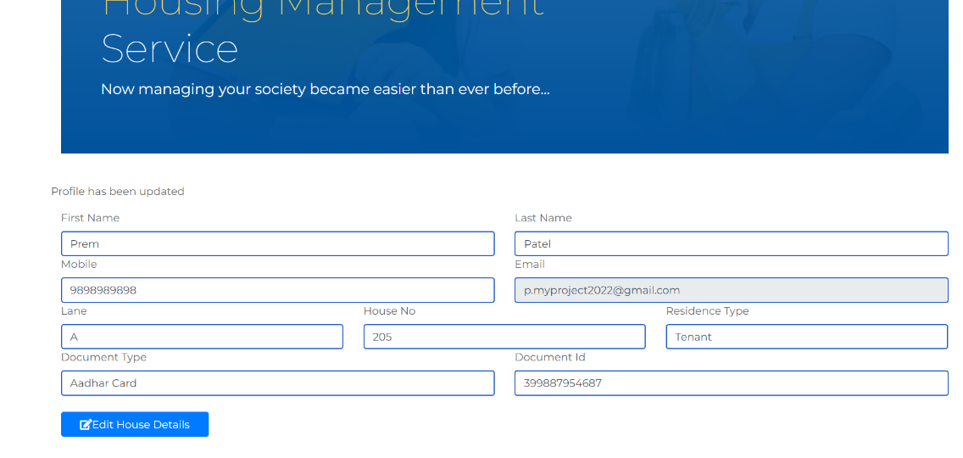
Member Index page and Edit House Details Page

Slide 31
THANK YOU

